Slide 1
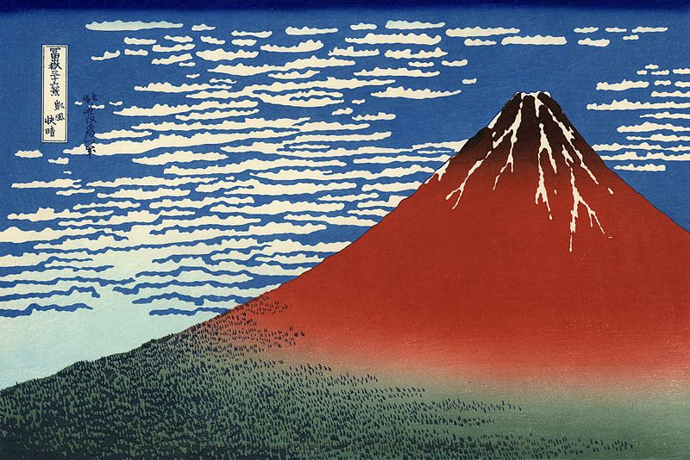
EARLY JAPAN
Katsushika Hokusai 葛飾 北斎(1769-1849)

Slide 2
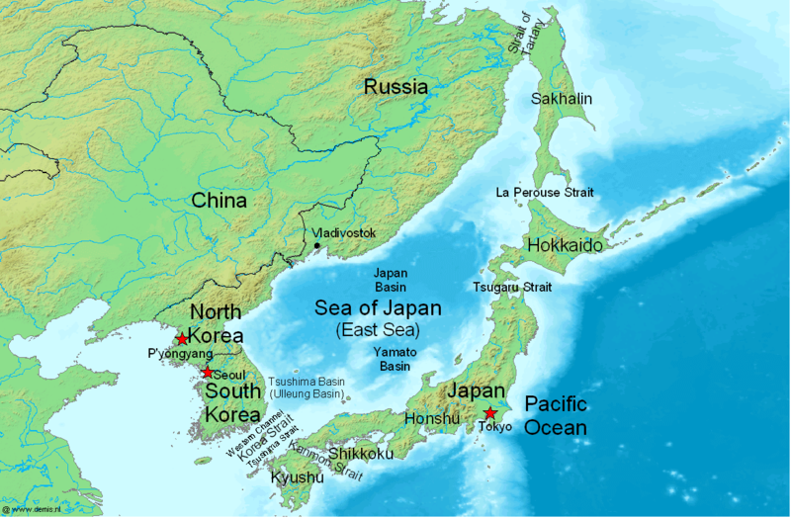

Slide 3
Geographical Characteristics
Japan’s size: smaller than California, but larger than Great Britain or Italy.
Less than 20% of Japan’s lands are arable, while 2/3 of Japan is mountainous terrain. Few rivers suited for navigation, so coastal shipping has been a major form of transportation.
Japan’s territory consists of four main islands; (North to South) Hokkaido, Honshu (largest and contains major cities), Shikoku, and Kyushu(More enlighten, seek the culture from china, and western countries).

Slide 4
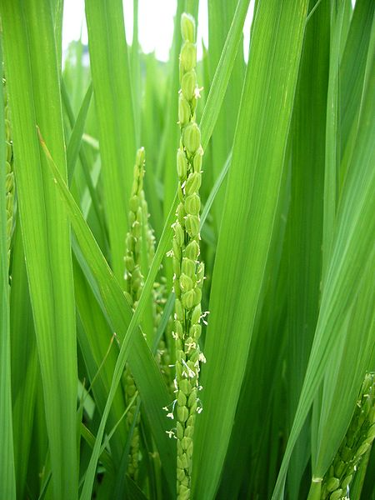
Climate & Agriculture
Japan’s climate resembles the climate of the US eastern seaboard. The country itself is on the same latitude as Southern Maine down to the state of Georgia.
Japan’s climate is described as ranging from humid continental to subtropical.
Rice and grains continue to be main crops; the southern half of the country is able to produce two harvests a year.
Japan has traditionally been able to support a large population through extremely intensive cultivation techniques; however, with changing diets, Japan now imports as large amount of its foodstuffs.

Slide 5
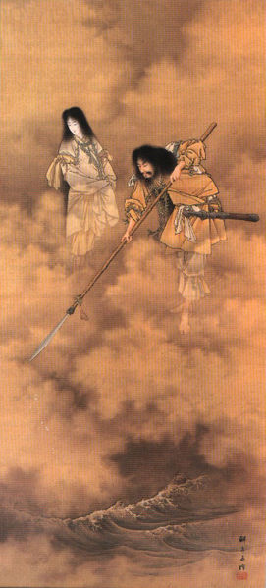
The Mythical Past
Izanagi イザナギ : central deity, along with his spouse, in the Japanese creation myth.
Izanami イザナミ : Shinto primordial deity and embodiment of the Earth and darkness; fatally wounded when giving birth to the fire god Kagutsuchi カグツチ.

Slide 6
The Mythical Past
Amaterasu 天照 : Izanagi’s daughter and Shinto sun goddess, ruler of Heaven, whose name means 'shining heaven.‘
Jimmu Tennō 神武天皇(711– 585 BCE): great grandson of Amateratsu and legendary first emperor of Japan. Tenno ("Heavenly Emperor") is the title given all subsequent emperors in Japan.
Kojiki 古事記(712): earliest history of Japan and source of the creation myths that explain the divine nature of the Japanese islands and the imperial clan.

Slide 7
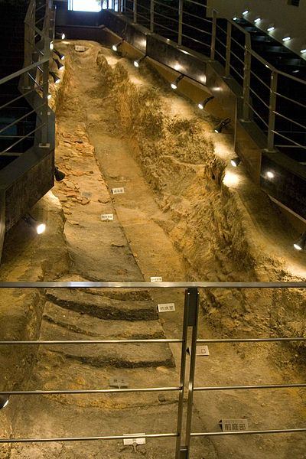
Archeological Past
Until the 8th-century A.D. peoples from Asia were travelling across the Korean region onto the island of Kyushu (Reischauer, p. 10). Since that time, there appears to have been near total cultural assimilation of the different ethnic groups that once co-existed, excluding the Ainu people of the far north
Japan’s cradle of civilization is said to be in the region of northern Kyushu (Yayoi culture), spreading early on up to the Kanto Plain.

Slide 8
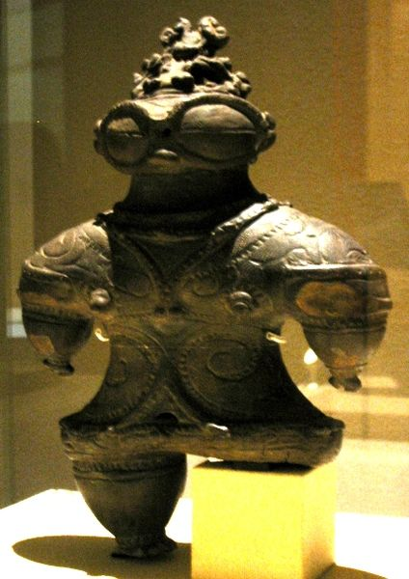
Jōmon culture (earliest times to 3rd century BCE)
Jomon 縄文: a Mesolithic culture with uncertain Ainu or/or Korean origins.
Uji 氏: clans led by patriarch (warrior/shaman).
Wet rice cultivation transform agriculture and settlement patterns

Slide 9
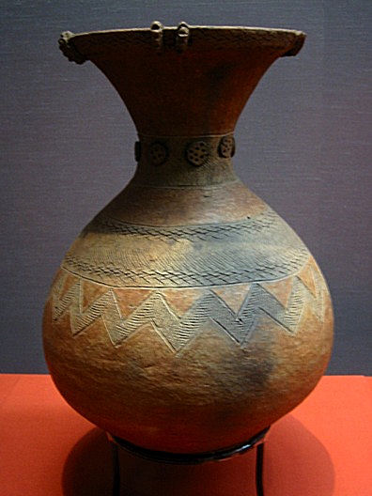
Infusion of Yayoi Culture
Yayoi 弥生 : immigrants to Japan via Korea from the 3rd century BCE; originally from northern China. Settlements found on southern Kyūshū and northern Honshū islands.
Early Yayoi society began the practice of worshipping kami 神, gods that represented forces of nature. Emperors were later considered kami as well.
Yayoi practiced polygamy.
Women could serve as priests.
Iron age began in around 2nd century CE.

